Slide 1


Tran Hoang Thien Phu
August 4th 2025

Slide 2

Outline
Executive Summary
Introduction
Methodology
Results
Conclusion
Appendix

Slide 3
Executive Summary
The following methodologies were used to analyze data:
Data Collection using web scraping and SpaceX API
Exploratory Data Analysis (EDA), including data wrangling, data visualization and interactive visual analytics
Machine Learning Prediction.
Summary of all results:
It was possible to collect valuable data from public sources
EDA allowed to identify which features are the best to predict success of launchings
Machine Learning Prediction showed the best model to predict which characteristics are important to drive this opportunity by the best way, using all collected data.

Slide 4
Introduction
Project background and context: This project analyzes historical SpaceX launch data to identify key factors that influence mission success. By applying exploratory data analysis and machine learning, we aim to predict launch outcomes and support decision-making in the aerospace industry. It serves as the final assignment for the Coursera Applied Data Science Capstone.
Problems you want to find answers:
What features impact launch success the most?
Can we accurately predict launch outcomes?
Which machine learning model performs best?
How do launch sites differ in success rates?

Slide 5

Section 1

Slide 6
Methodology
Executive Summary
Data collection methodology:
Describe how data was collected
Perform data wrangling
Describe how data was processed
Perform exploratory data analysis (EDA) using visualization and SQL
Perform interactive visual analytics using Folium and Plotly Dash
Perform predictive analysis using classification models
How to build, tune, evaluate classification models

Slide 7
Data Collection
Data was collected using the SpaceX public REST API (https://api.spacexdata.com/v4).
Python requests was used to query launch, rocket, payload, and launchpad data.
Multiple helper functions were implemented to extract:
BoosterVersion from rocket IDs
LaunchSite, Longitude, and Latitude from launchpad IDs
PayloadMass and Orbit from payload IDs
Block, ReusedCount, Outcome, etc. from core details.

Slide 8
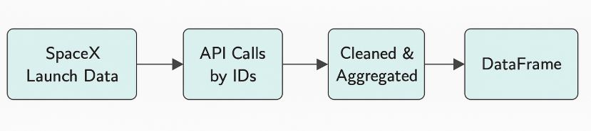
Data Collection – SpaceX API
Present your data collection with SpaceX REST calls using key phrases and flowcharts
Add the GitHub URL of the completed SpaceX API calls notebook (must include completed code cell and outcome cell), as an external reference and peer-review purpose:
https://github.com/tranhoangthienphu/Applied-Data-Science-Capstone/blob/cf92e8c938f8d0ced1b6073477af64fbad6e9471/jupyter-labs-spacex-data-collection-api.ipynb

Slide 9
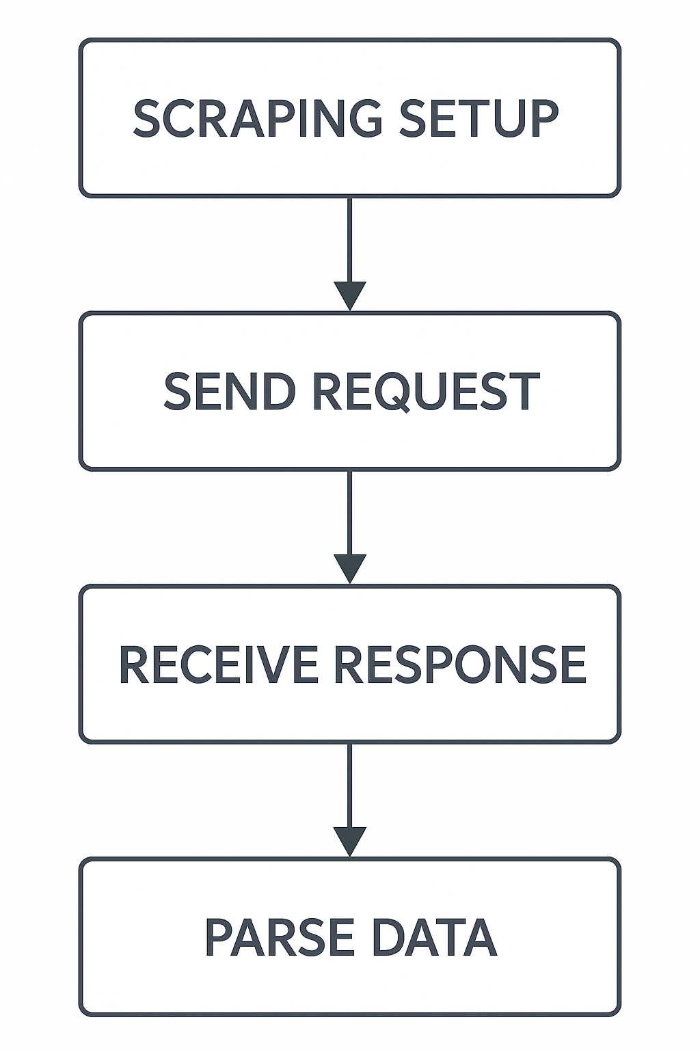
Data Collection - Scraping
Present your web scraping process using key phrases and flowcharts
Add the GitHub URL of the completed web scraping notebook, as an external reference and peer-review purpose
https://github.com/tranhoangthienphu/Applied-Data-Science-Capstone/blob/cf92e8c938f8d0ced1b6073477af64fbad6e9471/jupyter-labs-webscraping.ipynb

Slide 10
Data Wrangling
Describe how data were processed
You need to present your data wrangling process using key phrases and flowcharts
Add the GitHub URL of your completed data wrangling related notebooks, as an external reference and peer-review purpose

Slide 11
EDA with Data Visualization
Summarize what charts were plotted and why you used those charts:
Bar charts were used to display the number of launches by orbit type and launch site, helping identify the most frequently used orbits and locations.
Pie charts showed the proportion of successful vs. failed launches, offering a quick understanding of SpaceX’s overall success rate.
Scatter plots illustrated the relationship between payload mass and launch success, helping evaluate if heavier payloads affect outcomes.
Histograms were used to show the distribution of payload mass across different missions, highlighting common payload ranges.
Add the GitHub URL of your completed EDA with data visualization notebook, as an external reference and peer-review purpose:
https://github.com/tranhoangthienphu/Applied-Data-Science-Capstone/blob/cf92e8c938f8d0ced1b6073477af64fbad6e9471/EDA%20with%20Visualization%20Lab.ipynb

Slide 12
EDA with SQL
Using bullet point format, summarize the SQL queries you performed:
Retrieved average payload mass carried by F9 v1.1 boosters to analyze performance.
Identified the date of the first successful ground pad landing.
Listed boosters that succeeded in drone ship landings with specific payload conditions.
Counted total successful and failed mission outcomes for all launches.
Extracted boosters with the maximum payload using subqueries and aggregation.
Filtered 2015 launch failures on drone ships by month and site.
Ranked landing outcomes by frequency between specific dates using SQL sorting and grouping.
Add the GitHub URL of your completed EDA with SQL notebook, as an external reference and peer-review purpose: https://github.com/tranhoangthienphu/SQL.ipynb

Slide 13
Build an Interactive Map with Folium
Added markers to display all SpaceX launch sites, and circles to show the proximity around each site.
Used polylines to visually connect launch sites with nearest coastlines.
Purpose: to provide spatial insights on launch distribution, proximity to ocean, and success probability by location.
GitHub URL: https://github.com/tranhoangthienphu/Applied-Data-Science-Capstone/blob/cf92e8c938f8d0ced1b6073477af64fbad6e9471/Interactive%20Visual%20Analytics%20with%20Folium%20lab_launch_site_location.ipynb

Slide 14
Build a Dashboard with Plotly Dash
Dashboard Features:
Dropdown menu to select launch site (all sites or specific).
Interactive pie chart to show success rates by site or by success/failure for selected site.
Range slider to filter payload mass range.
Interactive scatter plot to explore correlation between payload and launch outcome, color-coded by booster version.
Why These Were Used:
Enable users to explore data dynamically.
Support better understanding of launch performance by site and payload.
Visualize relationships and trends for improved decision-making.
GitHub URL: https://github.com/tranhoangthienphu/Applied-Data-Science-Capstone/blob/cf92e8c938f8d0ced1b6073477af64fbad6e9471/spacex-dash-app.py

Slide 15
Predictive Analysis (Classification)
Summarize how you built, evaluated, improved, and found the best performing classification model:
Data was preprocessed and standardized.
Several classification models were trained and tuned using GridSearchCV: Logistic Regression
Support Vector Machine (SVM), Decision Tree, and K-Nearest Neighbors (KNN).
Each model's hyperparameters were optimized with 10-fold cross-validation.
Model performance was evaluated using accuracy scores and confusion matrices.

Slide 16
Predictive Analysis (Classification)
You need present your model development process using key phrases and flowchart:
Add the GitHub URL:
https://github.com/tranhoangthienphu/Applied-Data-Science-Capstone/blob/cf92e8c938f8d0ced1b6073477af64fbad6e9471/SpaceX_Machine%20Learning%20Prediction_Part_5.ipynb
Data preparation and standardization
Train-test split
Hyperparameter tuning with GridSearchCV
Model evaluation using test accuracy and confusion matrix
Comparison of model performances using a bar chart

Slide 17
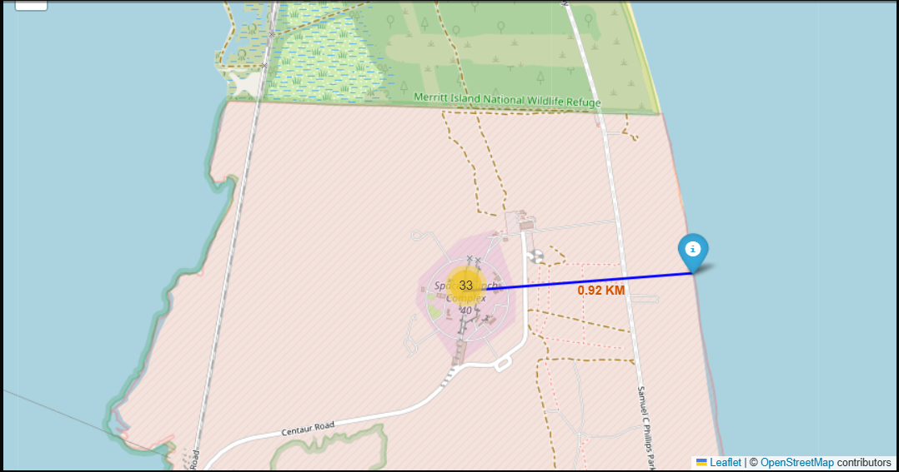
Results
Exploratory data analysis results: Uncovered relationships between payload mass, booster versions, launch sites, and mission outcomes using bar charts, pie charts, and scatter plots.
Interactive analytics demo in screenshots: Developed an interactive dashboard (Plotly Dash) and map (Folium) to explore launch data by site, payload range, and success classification.
Predictive analysis results: Evaluated four models — Logistic Regression, SVM, Decision Tree, and KNN — using GridSearchCV. Decision Tree achieved the best cross-validation accuracy.

Slide 18

Section 2

Slide 19
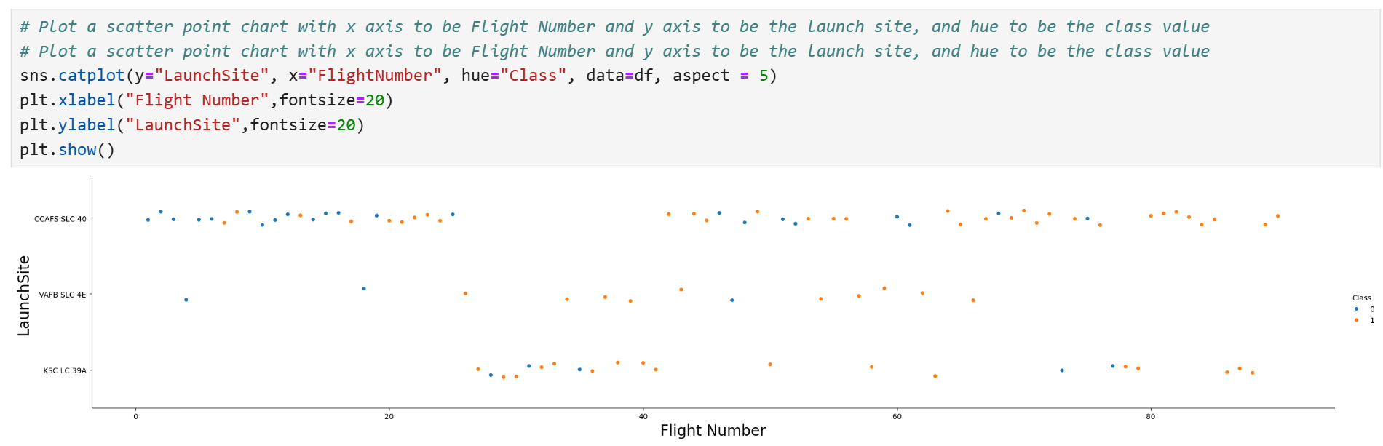
Flight Number vs. Launch Site
Show a scatter plot of Flight Number vs. Launch Site
CCAFS SLC 40 has the highest number of launches, with a balanced mix of successes and failures early on, but mostly successful outcomes in later flights.
KSC LC 39A shows a high success rate, especially in later flights.
VAFB SLC 4E has fewer launches, with mixed outcomes.
Conclusion: Launch success generally improves with higher flight numbers (experience), and success rates vary slightly by launch site.

Slide 20
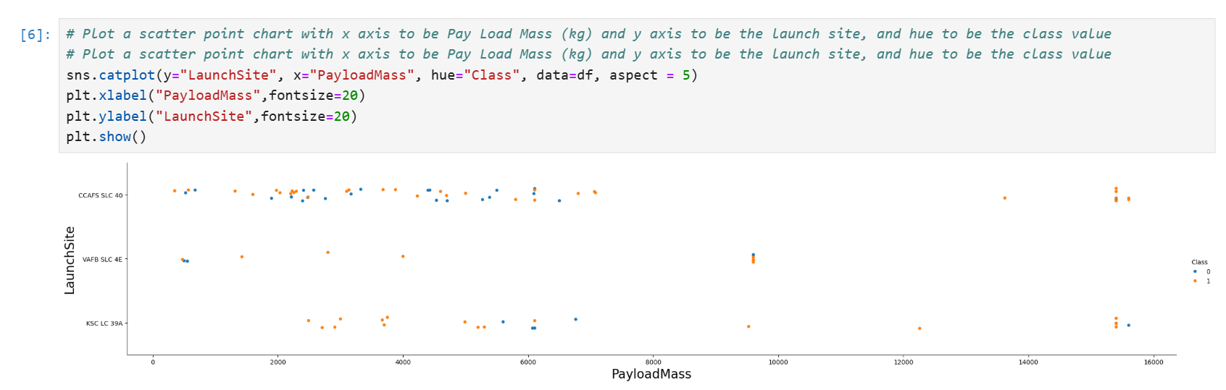
Payload vs. Launch Site
Show a scatter plot of Payload vs. Launch Site
Most launches with payloads below 6000 kg occurred at CCAFS SLC 40, showing a mix of success and failure.
High payload launches (over 10,000 kg) are more common at KSC LC 39A, and most of them were successful.
VAFB SLC 4E had fewer launches and lower payload masses, with varying outcomes.
Conclusion: Higher payloads, especially from KSC LC 39A, tend to have higher success rates, suggesting advanced readiness at that site.

Slide 21
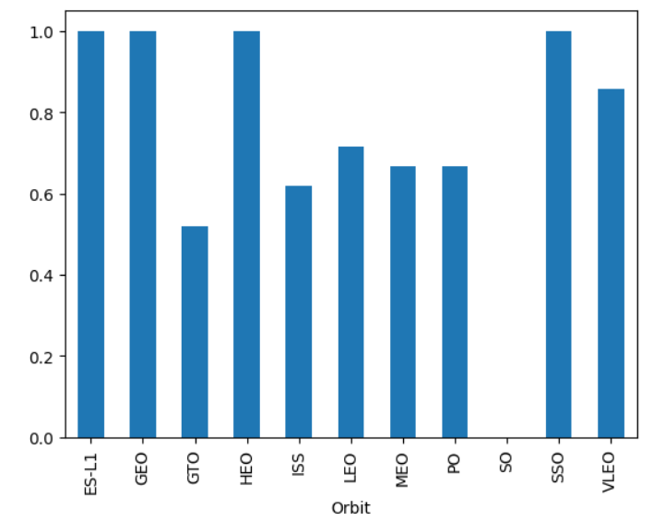
Success Rate vs. Orbit Type
Orbits such as ES-L1, GEO, HEO, and SSO have a 100% success rate, indicating highly reliable missions to these destinations.
GTO (Geostationary Transfer Orbit) has the lowest success rate, around 50%, suggesting more technical challenges or complexity.
Common orbits like LEO (Low Earth Orbit) and MEO (Medium Earth Orbit) have moderate success rates between 65%–75%.
Conclusion: The chart highlights that while most orbit types maintain high success rates, special attention may be needed for missions targeting GTO, where failure rates are noticeably higher.

Slide 22
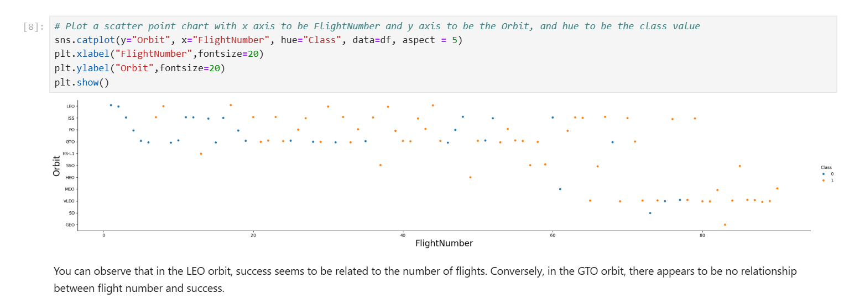
Flight Number vs. Orbit Type
The success of missions in LEO seems to benefit from accumulated launch experience, showing a trend of increasing reliability. In contrast, GTO missions show no strong correlation with flight history, suggesting intrinsic challenges associated with that orbit

Slide 23
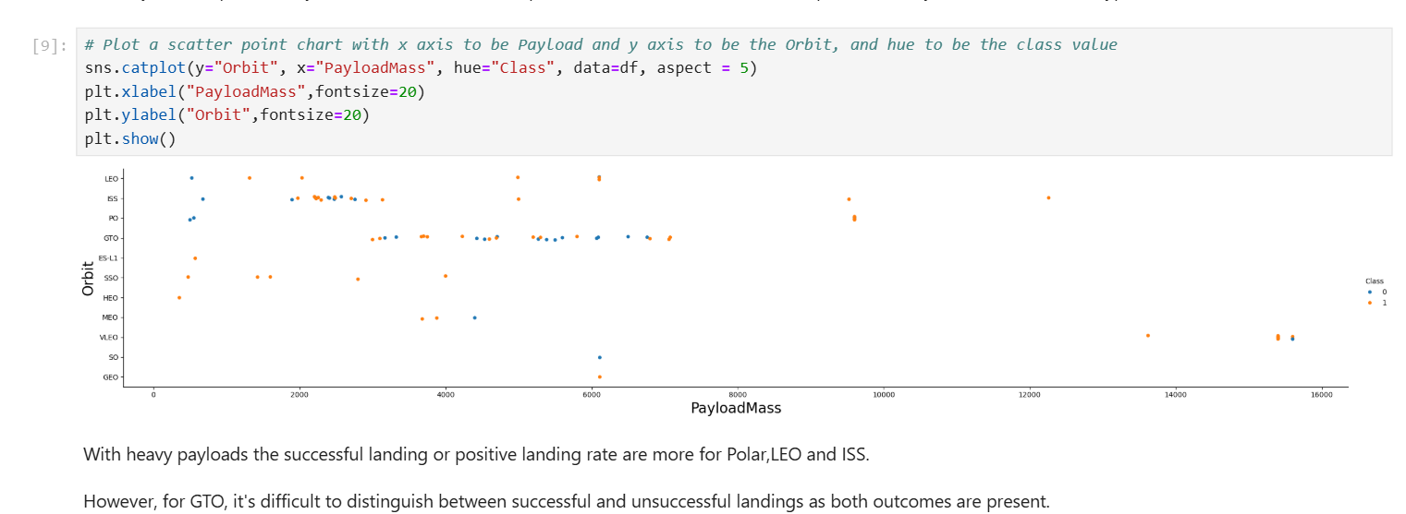
Payload vs. Orbit Type
While SpaceX missions with heavy payloads tend to show higher success rates for LEO, ISS, and Polar orbits, missions targeting GTO display a mixed success pattern, reflecting greater operational complexity or risks.

Slide 24
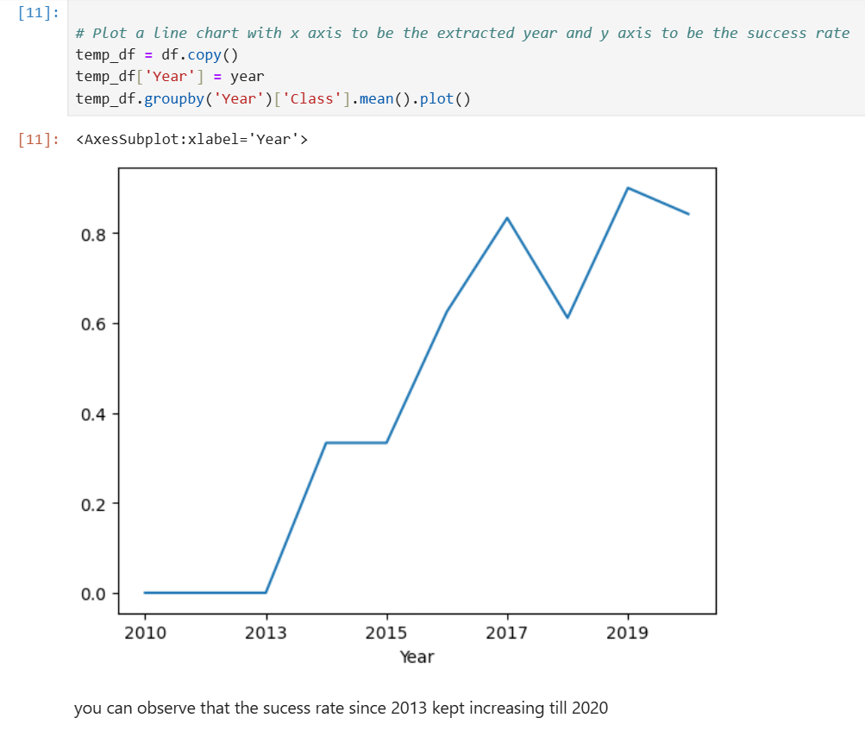
Launch Success Yearly Trend
Since 2013, SpaceX has shown a strong upward trend in mission success rate, peaking around 2019. This reflects consistent improvements in reliability and operational efficiency over time

Slide 25
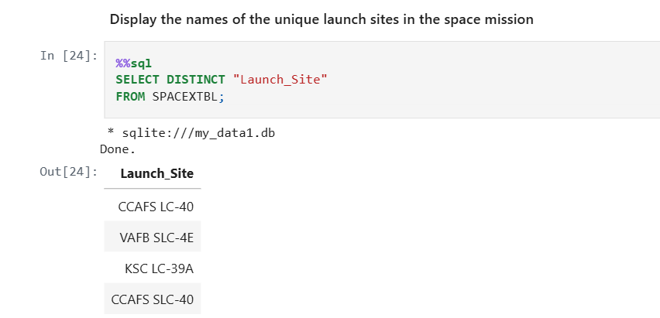
All Launch Site Names
Distinct Launch Sites:
CCAFS LC-40 – Cape Canaveral Air Force Station, Launch Complex 40
VAFB SLC-4E – Vandenberg Air Force Base, Space Launch Complex 4E
KSC LC-39A – Kennedy Space Center, Launch Complex 39A
CCAFS SLC-40 – (Appears to be a duplicate or naming inconsistency of CCAFS LC-40)

Slide 26
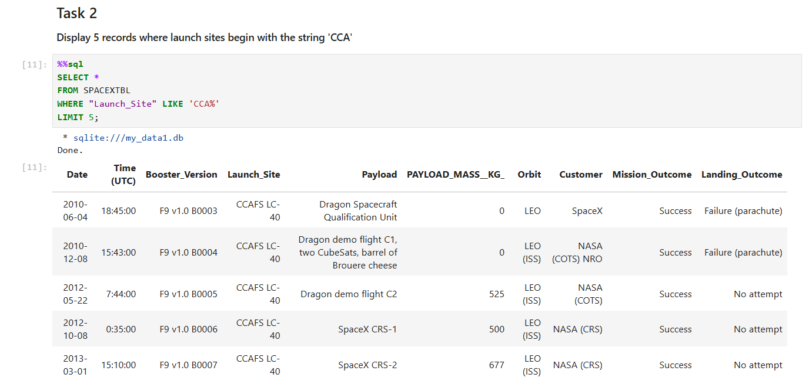
Launch Site Names Begin with 'CCA'
NASA’s Commercial Resupply Services (CRS) missions launched by SpaceX delivered a total of 45,596 kg of payload to their destinations. This highlights the significant contribution of SpaceX to NASA’s supply chain to the International Space Station (ISS).

Slide 27
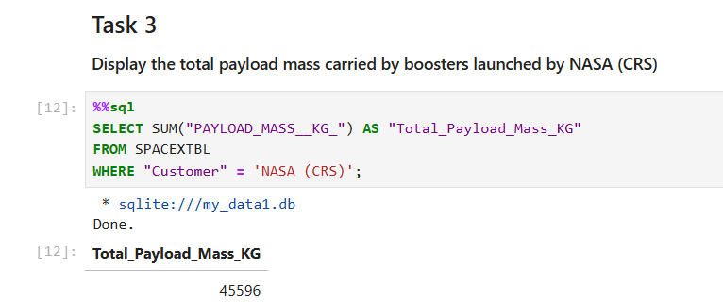
Total Payload Mass
Calculate the total payload carried by boosters from NASA
Present your query result with a short explanation here

Slide 28
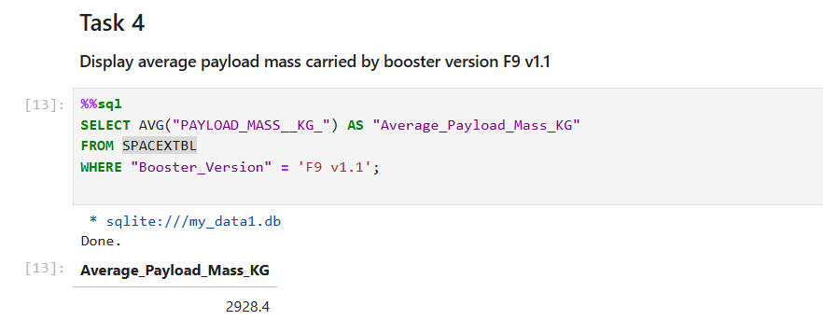
Average Payload Mass by F9 v1.1
The Falcon 9 version 1.1 booster typically carried a payload mass of around 2928.4 kg per launch, reflecting its operational capacity before newer versions like F9 FT and F9 B5 were introduced with higher performance.

Slide 29
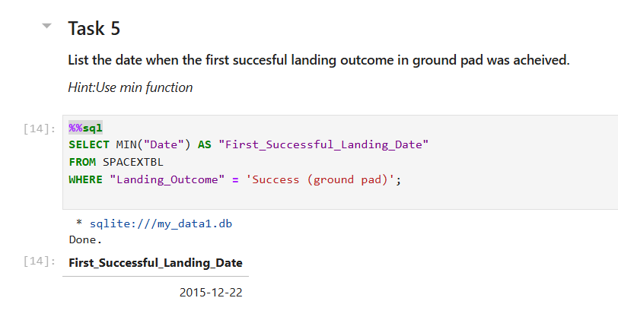
First Successful Ground Landing Date
SpaceX achieved its first ground pad landing success on December 22, 2015. This marked a major milestone in reusable rocket technology, showcasing the company’s ability to recover and potentially reuse rocket boosters landed on solid ground.

Slide 30
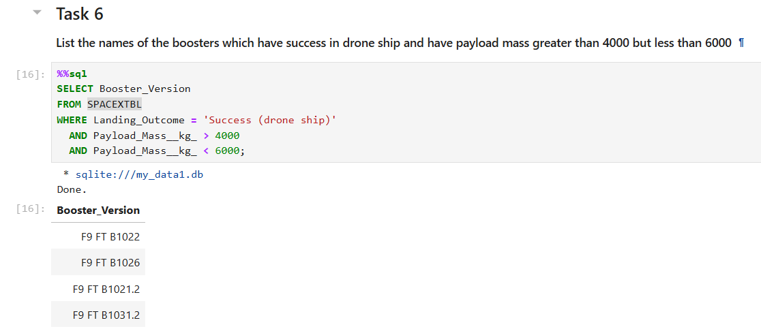
Successful Drone Ship Landing with Payload between 4000 and 6000
These four Falcon 9 Full Thrust (FT) boosters successfully landed on drone ships while carrying moderate to heavy payloads (between 4000–6000 kg). This highlights the reliability and reusability of these booster versions for mid-weight orbital missions.

Slide 31
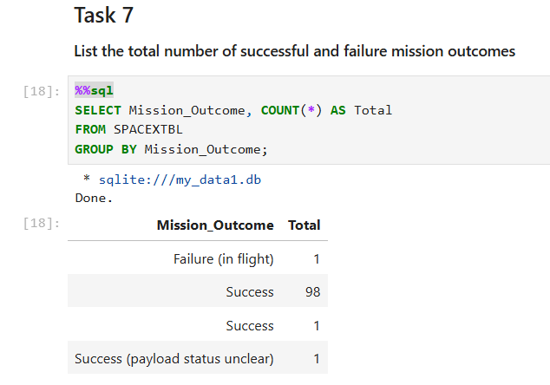
Total Number of Successful and Failure Mission Outcomes
SpaceX missions have a very high success rate, with over 97% of missions marked successful. This highlights the reliability and maturity of their launch systems. However, the slight duplication of "Success" suggests a potential inconsistency in labeling, which could benefit from data cleaning.

Slide 32
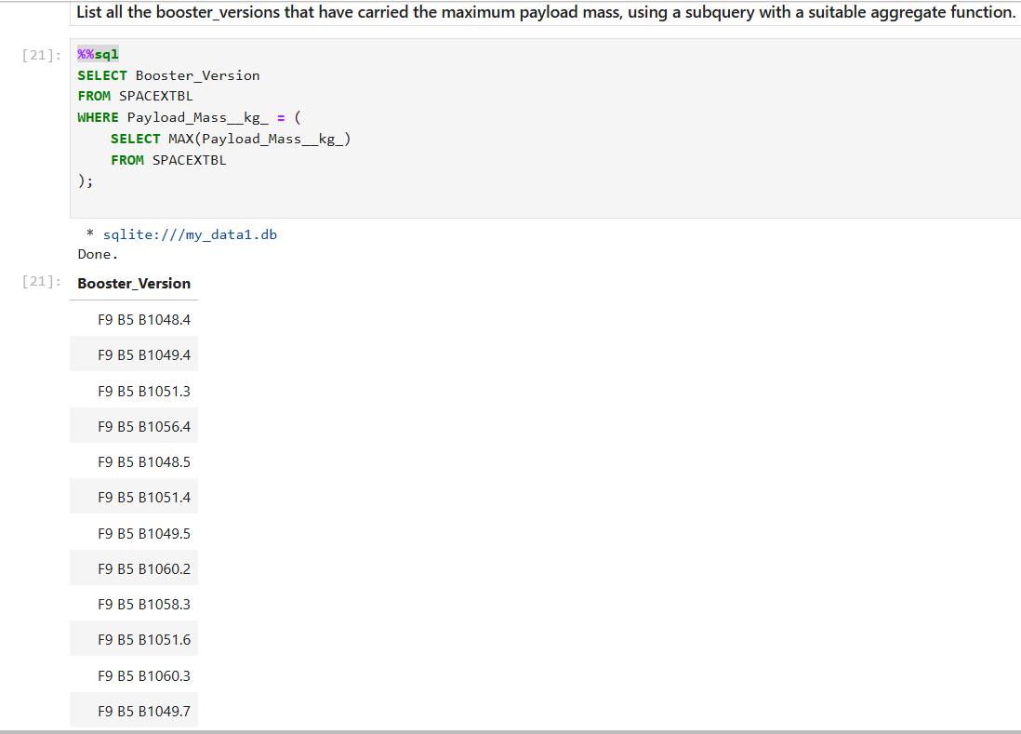
Boosters Carried Maximum Payload
All listed boosters are of type F9 B5, which is the Block 5 variant of Falcon 9.
Examples: F9 B5 B1048.4, B1049.4, B1051.3, etc.
This indicates that the Block 5 version is responsible for heaviest payload deliveries, showcasing its enhanced capacity.
Conclusion: This insight supports the conclusion that newer booster versions (like Block 5) play a crucial role in high-performance missions.

Slide 33
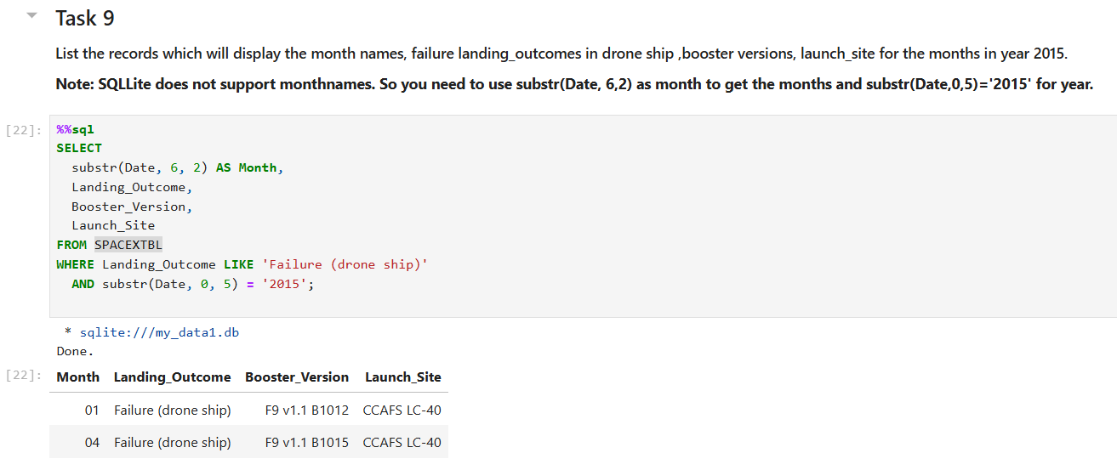
2015 Launch Records
January 2015: Failure using F9 v1.1 B1012 at CCAFS LC-40
April 2015: Failure using F9 v1.1 B1015 at CCAFS LC-40

Slide 34
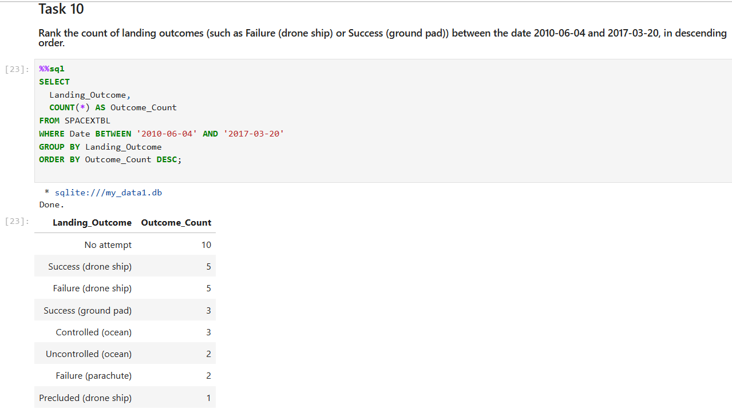
Rank Landing Outcomes Between 2010-06-04 and 2017-03-20
Most frequent outcome: No attempt (10 launches) – indicating many missions did not include a landing attempt.Present your query result with a short explanation here
Success (drone ship) and Failure (drone ship) both occurred 5 times each, showing a balanced but challenging performance on drone ships.
Success (ground pad) was recorded 3 times, same as Controlled (ocean) – both are less frequent but significant.
Rare outcomes include Failure (parachute), Uncontrolled (ocean), and Precluded (drone ship).
Conclusion: This result reflects early experimentation and progress in SpaceX's landing strategies during the specified period.

Slide 35

Section 3

Slide 36
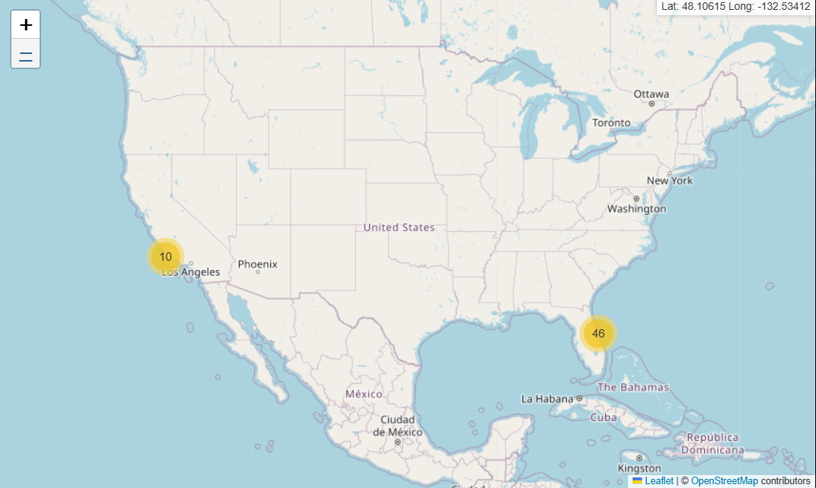
<Folium Map Screenshot 1>
It can be seen that the map shows the concentration locations of the launches, one launch point has 10 launches, the other has 46 launches.

Slide 37
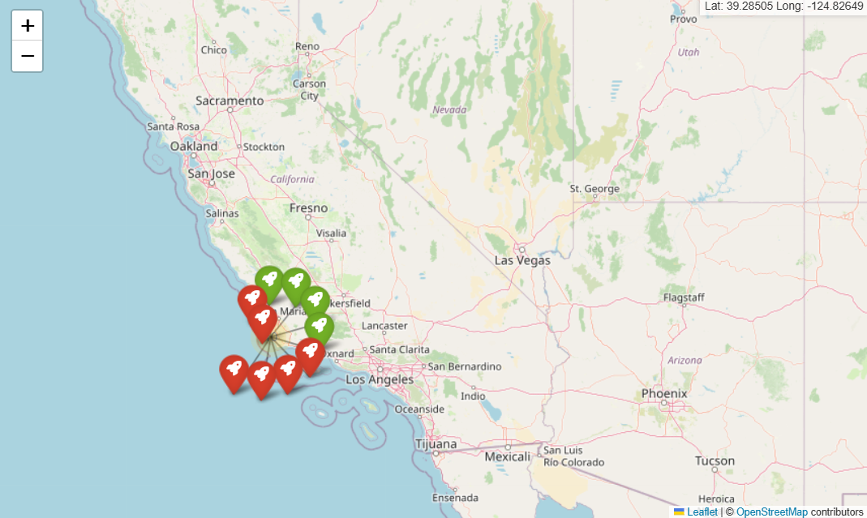
<Folium Map Screenshot 2>
launsite location includes launched points, green points are success, red points are failure

Slide 38
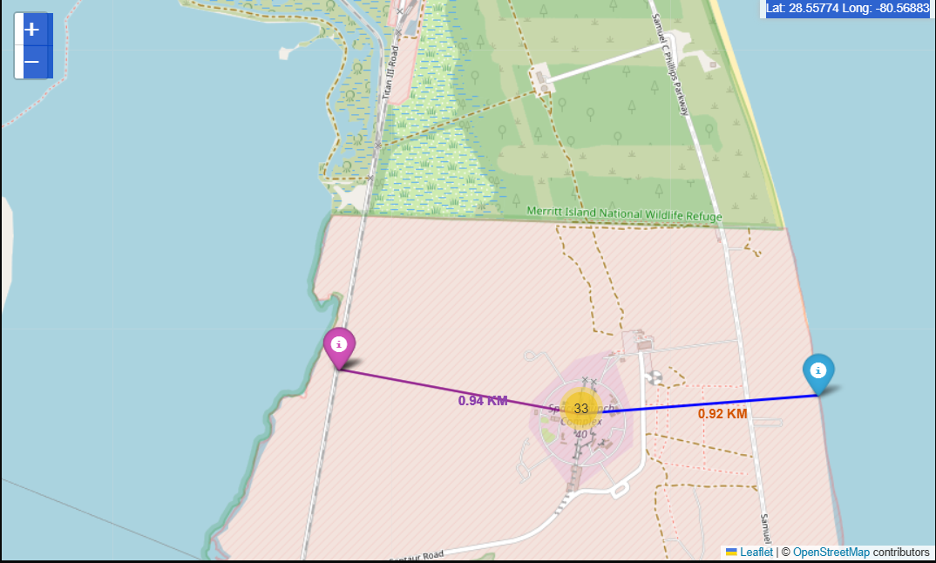
<Folium Map Screenshot 3>
The launch site is 0.94 km from the nearest highway (purple line)

Slide 39

Section 4

Slide 40
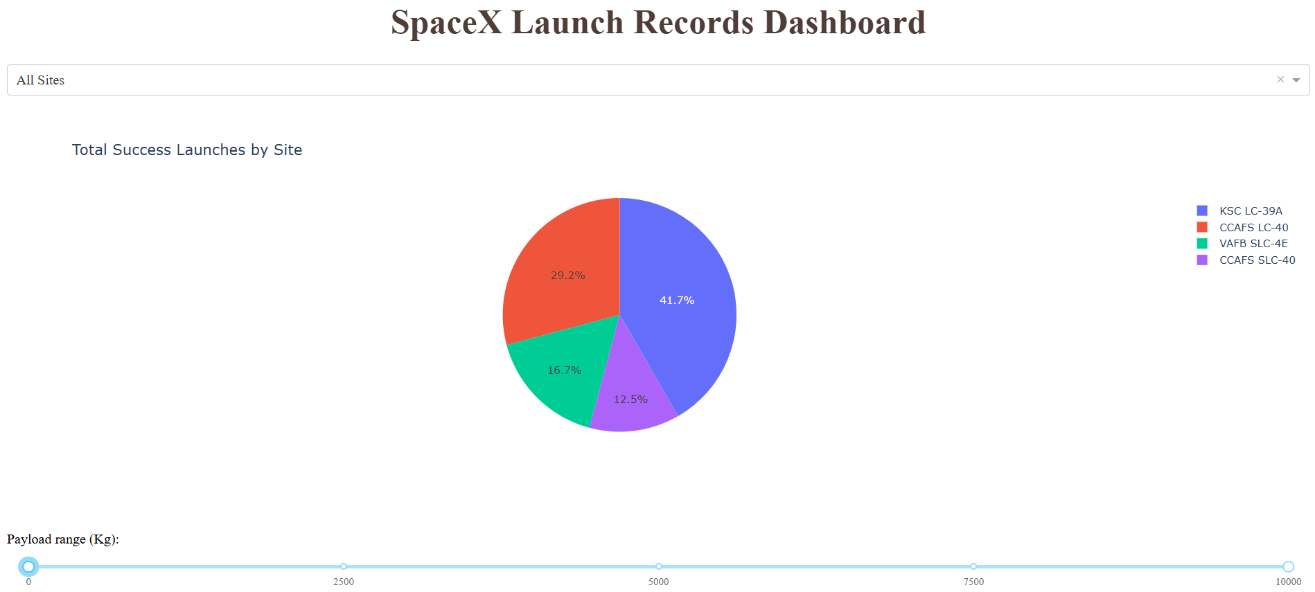
<Dashboard Screenshot 1>
KSC LC-39A is the top-performing launch site in terms of successful missions (41.7%)

Slide 41
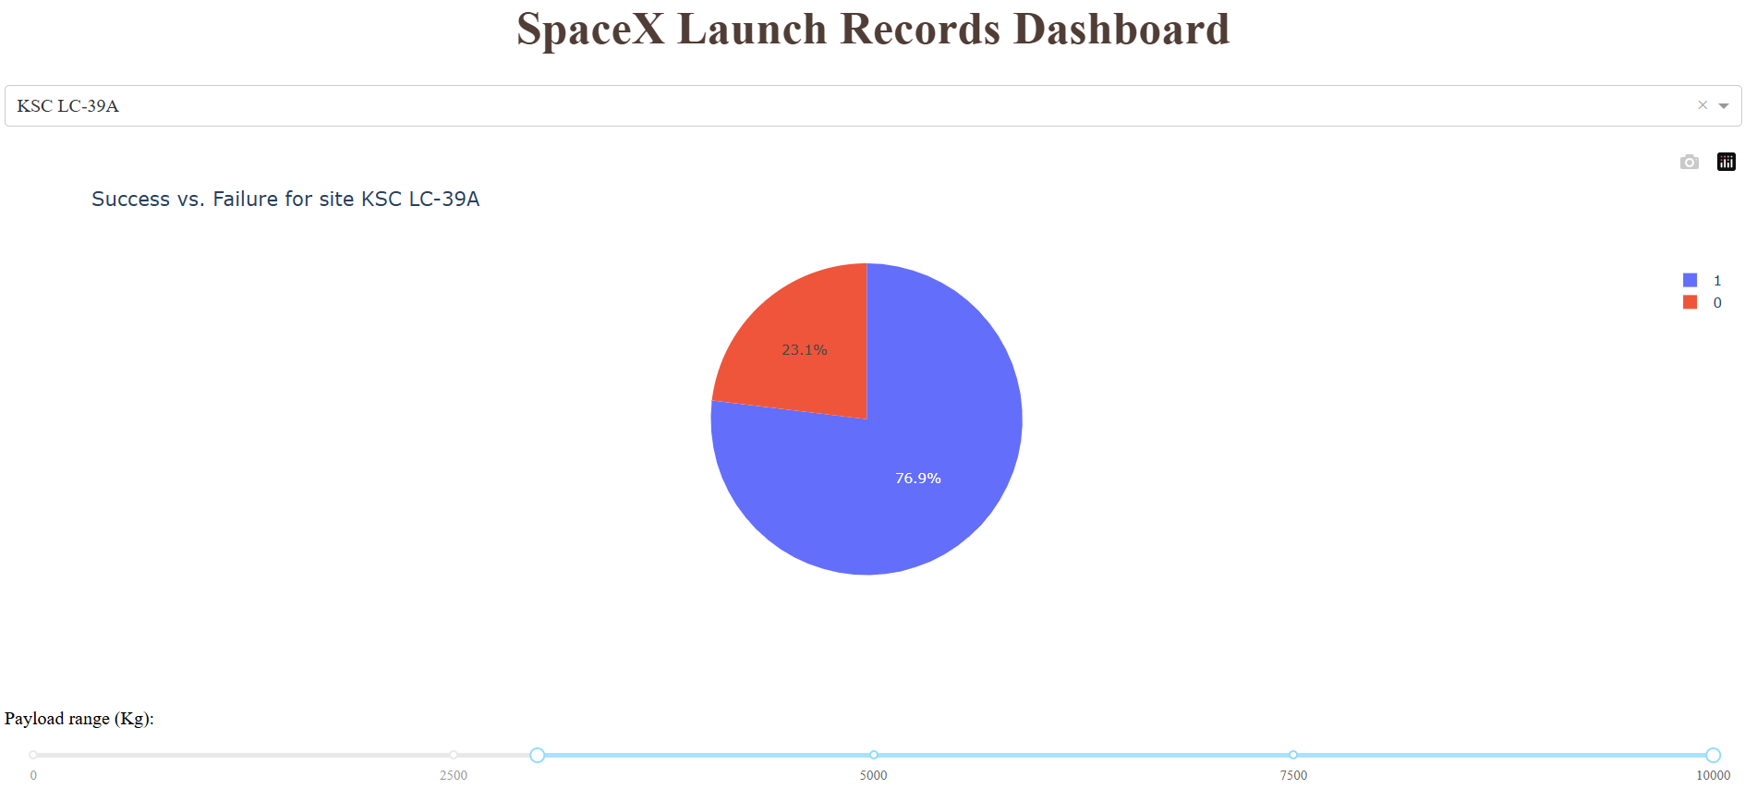
<Dashboard Screenshot 2>
This pie chart from the SpaceX Launch Records Dashboard displays the success vs. failure rate for launches at KSC LC-39A:
76.9% of launches were successful (class = 1, shown in blue).
23.1% of launches failed (class = 0, shown in red).
KSC LC-39A demonstrates a high launch success rate, making it one of the most reliable launch sites.

Slide 42
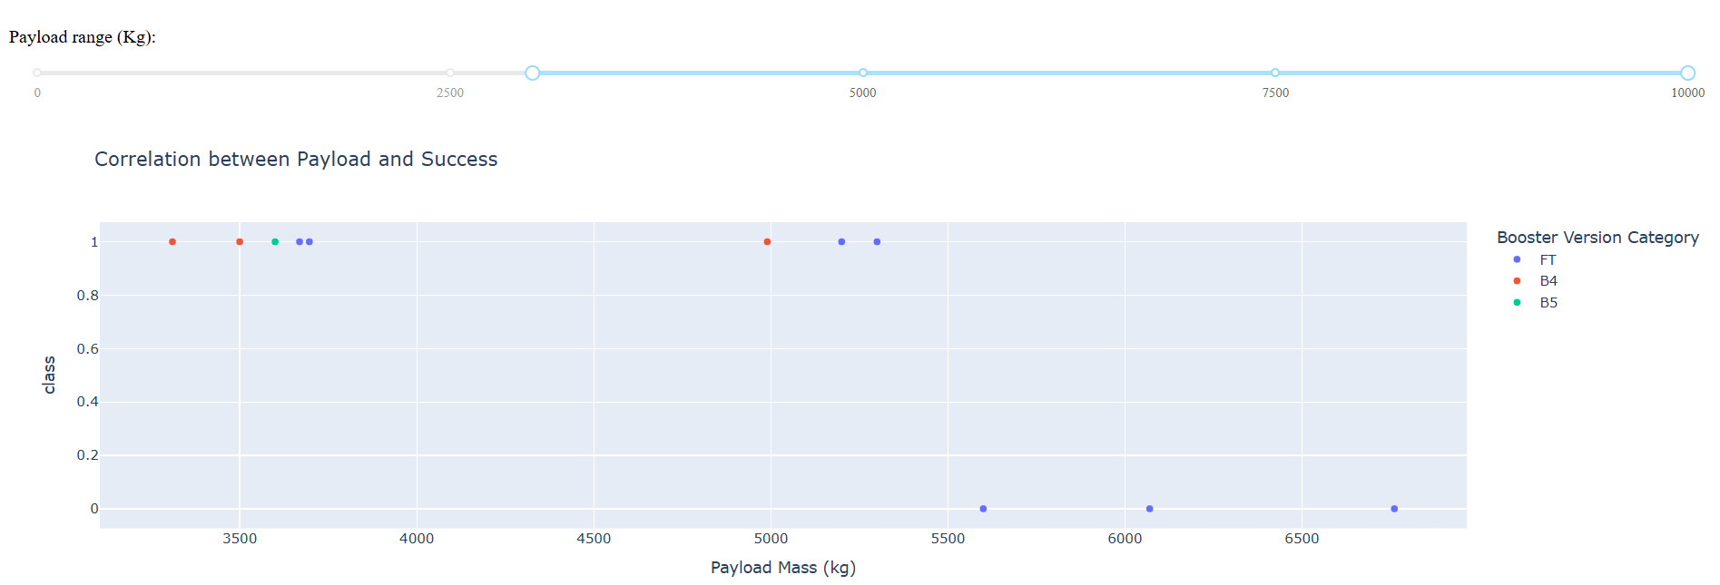
<Dashboard Screenshot 3>
Most missions with payloads between 3500–5000 kg were successful (class = 1).
Failures (class = 0) tend to appear more as the payload mass increases beyond 5500 kg.
Booster version FT appears more frequently and shows both successes and failures.
Conclusion: Lighter payloads (especially below ~5000 kg) are more likely to succeed, regardless of booster type.

Slide 43

Section 5

Slide 44
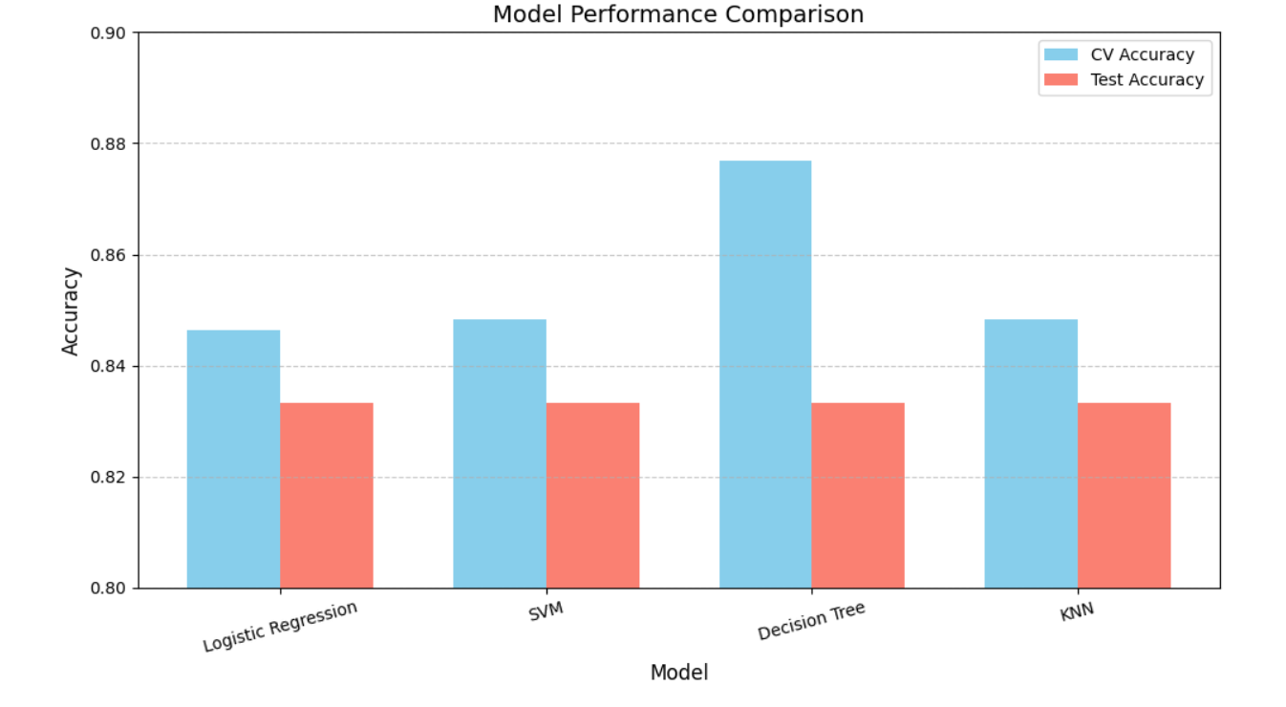
Classification Accuracy
Although Decision Tree had the best training performance, all models generalized similarly on test data. Hence, Decision Tree was selected for its balance of performance and interpretability.

Slide 45
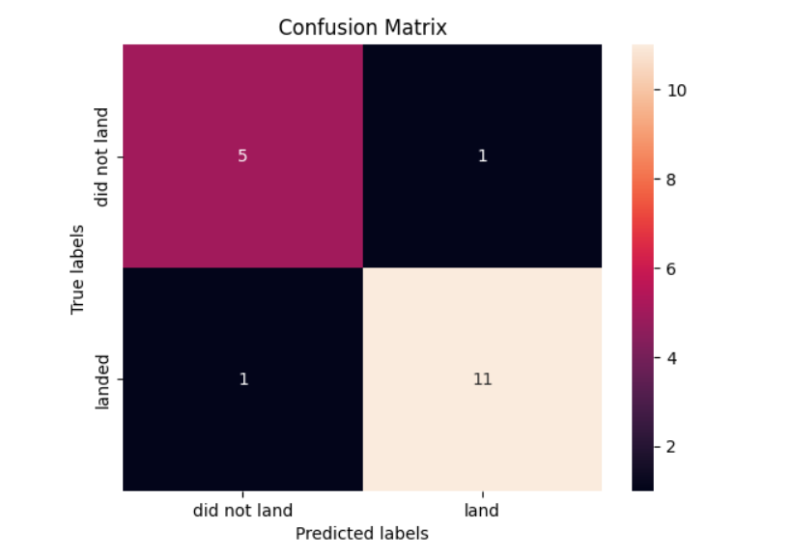
Confusion Matrix
The model performed well, correctly predicting 16 out of 18 cases. The balanced low number of false predictions indicates high accuracy and good generalization.

Slide 46
Conclusions
Multiple data sources were explored to iteratively refine insights and support data-driven conclusions.
Among all launch sites, KSC LC-39A emerged as the most reliable and successful.
Launch missions carrying payloads exceeding 7,000 kg demonstrated a lower risk profile.
While the majority of missions achieved success, the success rate of landings has shown consistent improvement over time—reflecting advancements in rocket design and operational procedures.
The Decision Tree Classifier proved to be the most effective model for predicting landing outcomes, offering potential for enhanced mission planning and profitability.

Slide 47
Appendix
Include any relevant assets like Python code snippets, SQL queries, charts, Notebook outputs, or data sets that you may have created during this project

Slide 48


